Slide 1
Azure DevOps Training Modernize your process with Azure DevOps and GitHub

Slide 2
Introduction to Azure Pipelines
Part 1 of 4 in the CI/CD with Azure Pipelines and GitHub series
MSUSDev@Microsoft.com
Feb, 2020

Slide 3


About us…
Sidney Andrews
Azure MVP, Microsoft Certified Trainer
For questions or help with this series
MSUSDev@Microsoft.com
For the lab guides and sample code
https://github.com/MSUSDEV/Azure-pipelines-with-GitHub

Slide 4
Setting the scene

Slide 5
Series roadmap
↪️ Session 1: Introduction to Azure Pipelines
Session 2: Continuous integration with GitHub and Azure
Session 3: Continuous deployment using Azure Pipelines
Session 4: Package management with Azure Artifacts

Slide 6
Today's agenda
Azure DevOps overview
Azure Pipelines
Building a pipeline for an application
Customizing the pipeline
Pipeline agents and containers

Slide 7
Technical requirements
What you need…
Some command-line experience
Some Git experience
What may help…
Some .NET experience

Slide 8
Azure DevOps
Modernize your deployment processes

Slide 9
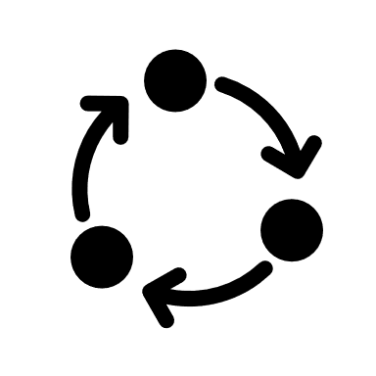



The DevOps methodology
Build
“…DevOps is the union of people,
process and products to enable
continuous delivery of value to
your business and its end-users…”
Deploy
Donovan Brown, Microsoft
Operate

Slide 10




The DevOps Toolkit (Microsoft)
GitHub
Visual Studio
Visual Studio Code
Build
Deploy
Operate
Azure Boards
Azure Repos
Azure Pipelines
Azure Tests
Azure Artifacts
Azure Monitor
Azure App Insights
Azure Security Center

Slide 11



Challenge of DevOps: Different approaches, same cloud endpoint
Application
DevTeam1
Application
DevTeam2
Application
DevTeam3
PRO’s:
DevTeams can run independently
DevTeams are in control
DevTeams enjoy their work
CON’s:
Different teams = different approaches
Different teams = different results
Operational challenges
Security challenges

Slide 12
Solution of DevOps: Same approach, same toolkit, same cloud endpoint
Application
DevTeam1
DEVOPS
Application
DevTeam2
Application
DevTeam3
PRO’s:
DevTeams can run independently
DevTeams are in control
DevTeams enjoy their work
More PRO’s:
Different teams = same approach
Different teams = same results
Operational benefits
Governed and Controlled

Slide 13





Introducing Azure DevOps
“… Azure DevOps is a suite of products that allows any organization to do better DevOps…”
Azure Boards
Azure Pipelines
Azure Repos
Deliver value to your users faster using proven agile tools to plan, track, and discuss work across your teams.
Build, test, and deploy with CI/CD that works with any language, platform, and cloud. Connect to GitHub or any other Git provider and deploy continuously.
Get unlimited, cloud-hosted private Git repos and collaborate to build better code with pull requests and advanced file management.
Azure Test Plans
Azure Artifacts
Test and ship with confidence using manual and exploratory testing tools.
Create, host, and share packages with your team, and add artifacts to your CI/CD pipelines with a single click.

Slide 14




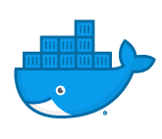
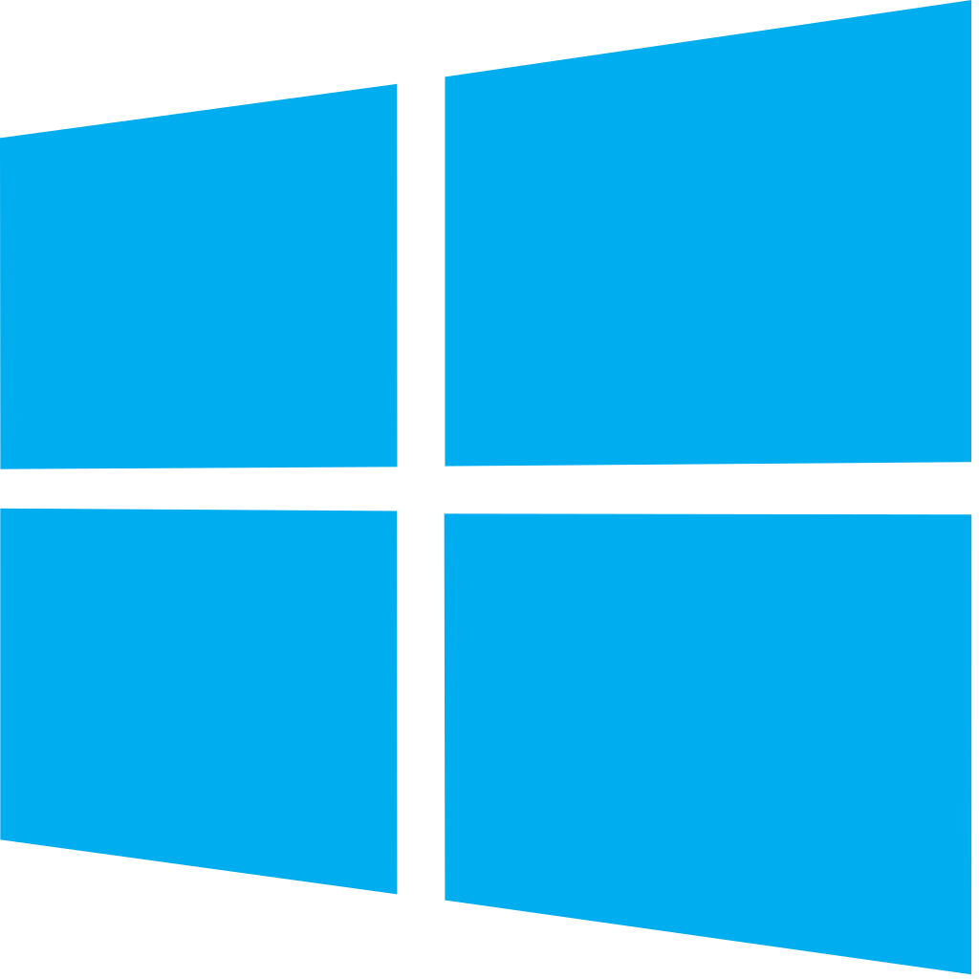


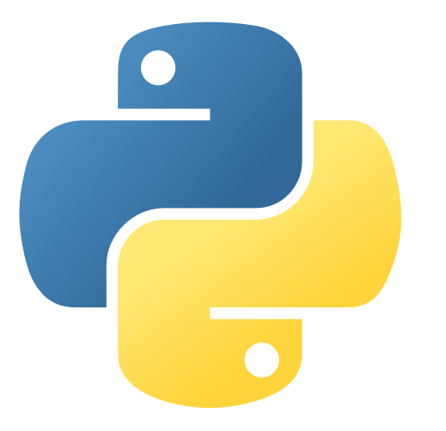




Azure DevOps: Choose what you love
Your tools, languages, and clouds
Any cloud, any platform, whether public, hybrid, on-premises
Developers are still in control of the language and process they want to keep using…
Azure DevOps integrates with existing dev tools, or can replace most of them… you choose!!

Slide 15
Demo
Creating an open-source Azure DevOps Project

Slide 16
Azure Pipelines
Implement CI/CD for your organization

Slide 17

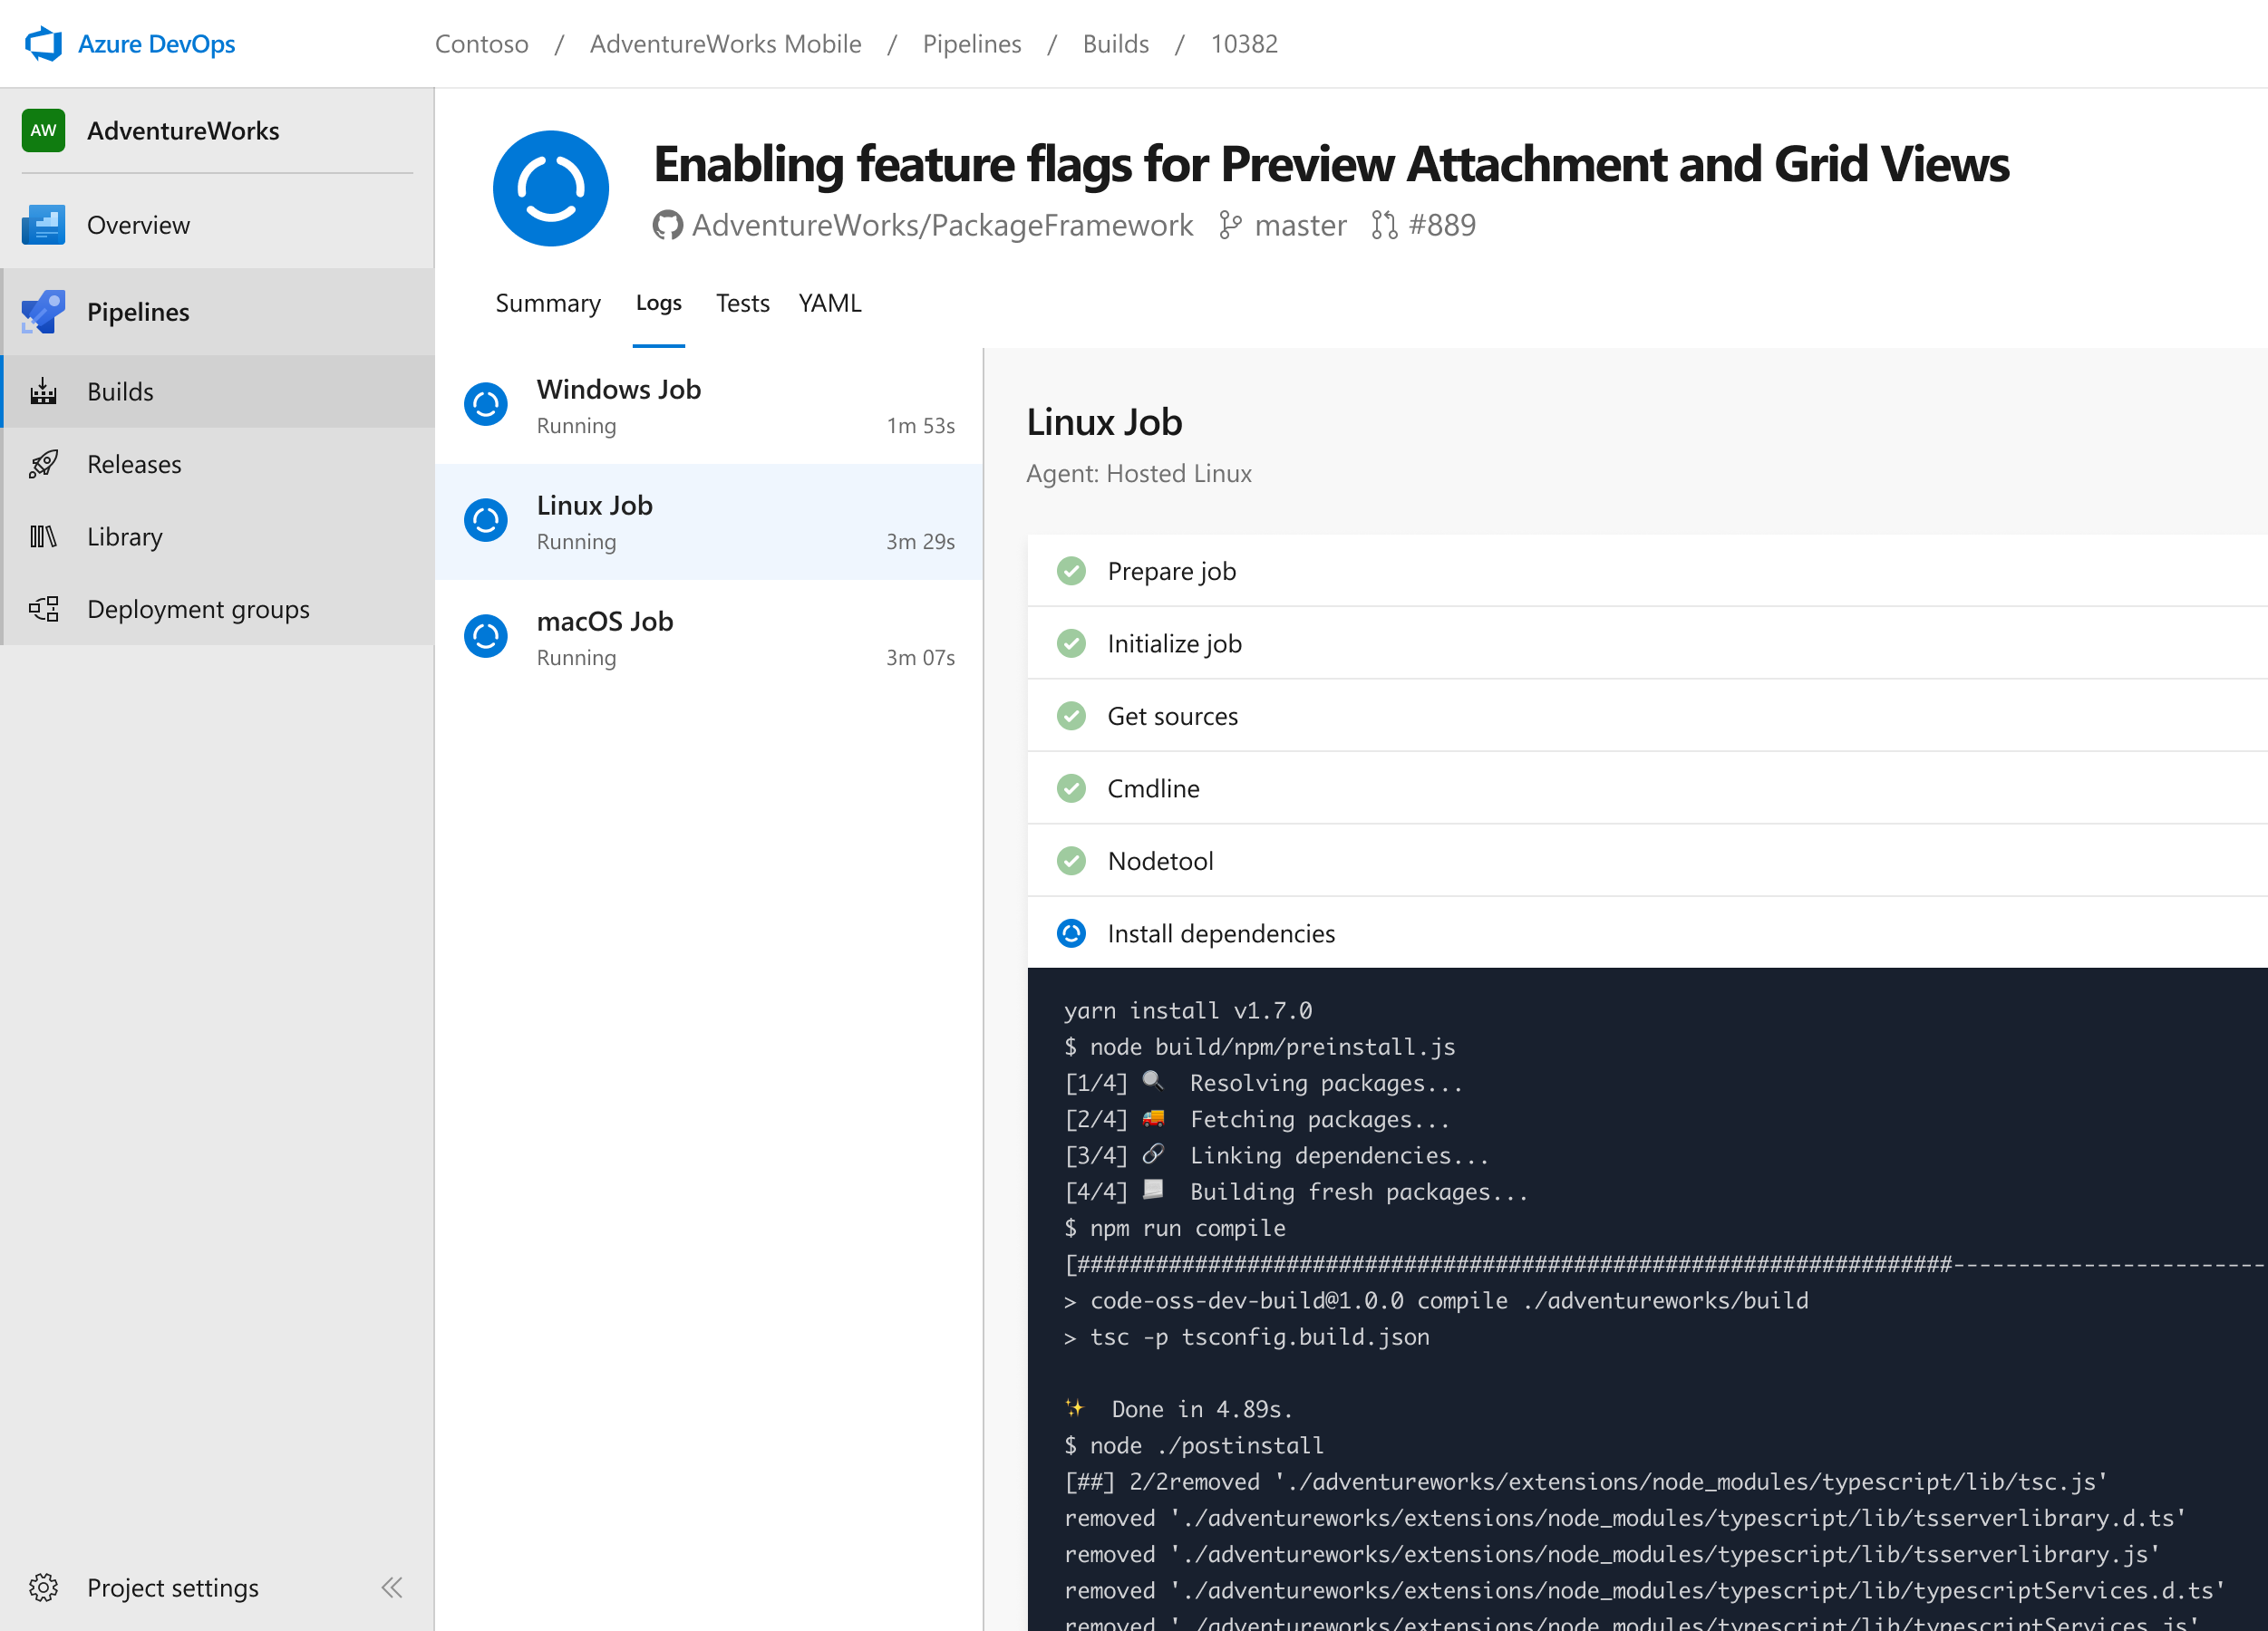


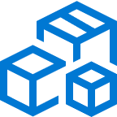
Azure Pipelines
Cloud-hosted pipelines for Linux, Windows and macOS.
Any language, any platform, any cloud
Build, test, and deploy Node.js, Python, Java, PHP, Ruby, C/C++, .NET, Android, and iOS apps. Run in parallel on Linux, macOS, and Windows. Deploy to Azure, AWS, GCP or on-premises
Extensible
Explore and implement a wide range of community-built build, test, and deployment tasks, along with hundreds of extensions from Slack to SonarCloud. Support for YAML, reporting and more
Containers and Kubernetes
Easily build and push images to container registries like Docker Hub and Azure Container Registry. Deploy containers to individual hosts or Kubernetes.
➔
https://azure.com/pipelines

Slide 18
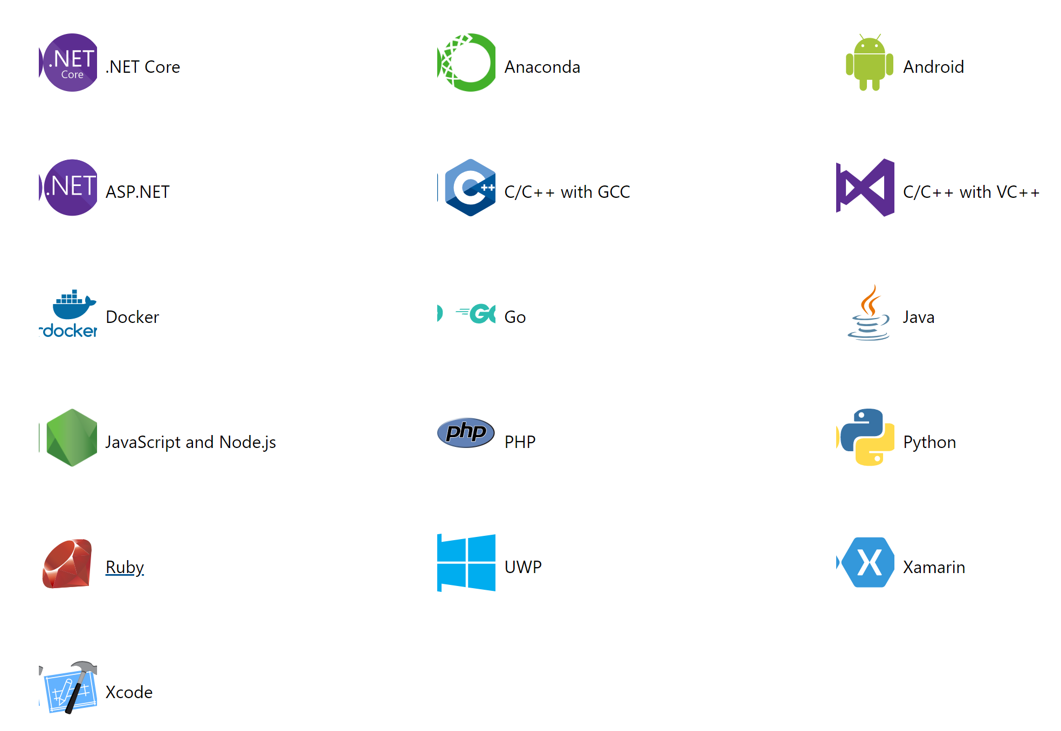
Running a Build with Azure DevOps Pipelines
Supporting multiple languages
Prerequisites:
A GitHub Account
An Azure DevOps Organization
Application Source Code
Based on your source code, Azure DevOps Pipelines “recognizes” the capabilities
The output of the Pipelines process is a “Azure-Pipelines.yml” file

Slide 19
Pipeline hierarchy
Stage
Job
Step
Step
Job
Pipeline
Step
Step
Stage
Job
Step
Step

Slide 20
Stages
Continuous Integration
Job
Build our project
Step
Step
Job
Pipeline
Step
Step
Continuous Deployment
Send to production
Job
Step
Step

Slide 21
Jobs
Continuous Integration
Use the CLI
Send to production
Build
Step
Step
Test
Pipeline
Step
Step
Continuous Deployment
Deploy to the cloud
Push to Azure
Step
Step

Slide 22
Steps
Continuous Integration
Build
Use the CLI
Restore Packages
Build
Test
Pipeline
Build
Run Unit Tests
Continuous Deployment
Built-in tasks
Push to Azure
Push to ACI
Validate

Slide 23
Types of steps
Script
Run any command-line script
Examples:
echo 'Hello World'
dotnet build
dir
Use the CLI
Task
Run one of the built-in tasks
Examples
Publish to Azure
Create an Artifact
Push to GitHub

Slide 24
Example repository
https://dev.azure.com/seesharprun/Webinar

Slide 25
Demo
Building a project with a starter pipeline

Slide 26
Building a pipeline for an application
Build an application using CLI commands

Slide 27
Pipeline hierarchy, again…
Stage
Job
Step
Step
Job
Pipeline
Step
Step
Stage
Job
Step
Step

Slide 28
Single stage pipeline
Stage
Job
Step
Step
Job
Pipeline
Step
Step

Slide 29
Build and test pipeline
Continuous Integration
Build
Use the CLI
Restore Packages
Build
Test
Pipeline
Build
Run Unit Tests

Slide 30
Information from the developer team
Language | Install Required Packages | Run Application
.NET Core | dotnet restore | dotnet run
Node.js | npm install | node [file.js]
Python | pip install [name] | python [file.py]
Ruby | gem install [name] | ruby [file.rb]

Slide 31
.NET guidance from the developers
 | .NET Core CLI
Install packages | dotnet restore
Build project | dotnet build
Run project | dotnet run
Test project | dotnet test
Publish project | dotnet publish

Slide 32
Build and test pipeline
Continuous Integration
Build
Use the CLI
Restore Packages
Build
Test
Pipeline
Build
Run Unit Tests

Slide 33
Use the CLI in the pipeline
Continuous Integration
Build
Use the CLI
dotnet restore
dotnet build
Test
Pipeline
dotnet build
dotnet test

Slide 34
Start with your stages array…
stages:
List of stages

Slide 35
Start with your stages array…
stages:
- stage: <name_of_stage>
- stage: <name_of_stage>

Slide 36
Start with your stages array…
stages:
- stage: continuous_integration
Stage name

Slide 37
Then add jobs…
stages:
- stage: continuous_integration
jobs:
List of jobs

Slide 38
Then add jobs…
stages:
- stage: continuous_integration
jobs:
- job: <job_name>
- job: <job_name>

Slide 39
Then add jobs…
stages:
- stage: continuous_integration
jobs:
- job: build
Job name

Slide 40
Finally, add steps to the job…
stages:
- stage: continuous_integration
jobs:
- job: build
steps:
List of steps

Slide 41
Types of steps
Script
Run any command-line script
Examples:
echo 'Hello World'
dotnet build
dir
Use the CLI
Task
Run one of the built-in tasks
Examples
Publish to Azure
Create an Artifact
Push to GitHub

Slide 42
Finally, add steps to the job…
stages:
- stage: continuous_integration
jobs:
- job: build
steps:
List of steps

Slide 43
Finally, add steps to the job…
stages:
- stage: continuous_integration
jobs:
- job: build
steps:
- script: <some_script_to_execute>
Command line

Slide 44
Finally, add steps to the job…
stages:
- stage: continuous_integration
jobs:
- job: build
steps:
- script: <some_script_to_execute>
- task: <name_of_builtin_task>
Built-in task

Slide 45
Finally, add steps to the job…
stages:
- stage: continuous_integration
jobs:
- job: build
steps:
- script: <some_script_to_execute>

Slide 46
Word from the developers…
dotnet restore
Restore NuGet packages

Slide 47
Finally, add steps to the job…
stages:
- stage: continuous_integration
jobs:
- job: build
steps:
- script: <some_script_to_execute>

Slide 48
Finally, add steps to the job…
stages:
- stage: continuous_integration
jobs:
- job: build
steps:
Restore NuGet packages
- script: dotnet restore

Slide 49
Word from the developers…
dotnet build
Build the project

Slide 50
Finally, add steps to the job…
stages:
- stage: continuous_integration
jobs:
- job: build
steps:
- script: dotnet restore

Slide 51
Finally, add steps to the job…
stages:
- stage: continuous_integration
jobs:
- job: build
steps:
- script: dotnet restore
- script: dotnet build
Build the project

Slide 52
Demo
Building a .NET project using a pipeline

Slide 53
Customizing the pipeline
Making it easier to manage pipelines

Slide 54
Sample pipeline
stages:
- stage: <stage_name>
jobs:
- job: <job_name>
steps:
- script: <script_to_run>
- script: <script_to_run>

Slide 55
Sample pipeline with hardcoded names
stages:
- stage: continuous_integration
jobs:
- job: build
steps:
- script: dotnet restore
- script: dotnet build

Slide 56
Sample pipeline with hardcoded names
stages:
- stage: continuous_integration
jobs:
- job: build
steps:
- script: dotnet restore
- script: dotnet build

Slide 57
Sample pipeline with friendly names
stages:
- stage: continuous_integration
displayName: Continuous Integration
jobs:
- job: build
displayName: Build
steps:
- script: dotnet restore
displayName: Restore NuGet packages
- script: dotnet build
displayName: Build .NET Core project

Slide 58
Demo
Creating friendly names

Slide 59
Once again, the pipeline hierarchy
Stage
Job
Step
Step
Job
Pipeline
Step
Step
Stage
Job
Step
Step

Slide 60
YAML schema documentation
https://docs.microsoft.com/azure/devops/pipelines/yaml-schema

Slide 61
Multiple stages and multiple jobs
Stage
Job
Step
Step
Job
Pipeline
Step
Step
Stage
Job
Step
Step

Slide 62
Single-stage pipeline
Job
Infer that there is only a single stage
Step
Step
Job
Step
Pipeline
Step
Job
Step
Step

Slide 63
Single job pipeline
Step
Infer that there is only a single stage
Infer that there is only a single job
Step
Step
Step
Step
Pipeline
Step

Slide 64
Demo
Slimming down a pipeline

Slide 65
Word from the developers…
dotnet publish --configuration Release --output <folder>
Publish an executable

Slide 66
Word from the developers…
dotnet publish --configuration Release --output <folder> --self-contained --runtime win-x64 /p:PublishSingleFile=true
Update to .NET Core 3.0
Advanced Publish

Slide 67
Demo
Publishing a .NET project

Slide 68
Pipeline agents and containers
Controlling the build enviornment

Slide 69
Agents
Azure Pipelines service
Agent pools
Microsoft hosted agents
Default
Hosted
1
2
3
4
5
6
7
8
Self hosted agents
1
2
3
4

Slide 70
Microsoft-hosted agents
Image | Specification
Windows Server 2019 Visual Studio 2019 | windows-latest windows-2019
Windows Server 2016 Visual Studio 2017 | vs2017-win2016
Ubuntu 18.04 | ubuntu-latest ubuntu-18.04
Ubuntu 16.04 | ubuntu-16.04
macOS X Mojave 10.14 | macOS-latest macOS-10.14
macOSX Catalina 10.15 | macOS-10.15

Slide 71
Included software ubuntu-16.04
7-Zip
Ansible
AzCopy
Azure CLI
AWS CLI
Clang
Cmake
Docker
.NET Core SDK
Erlang
Firefox
Git
Heroku CLI
Maven
Helm
Kubectl
MySQL Client Tools
Node.js
Grunt
Gulp
PHP
Terraform
Android SDK
Google APIs
Python
Ruby

Slide 72
YAML schema documentation
https://docs.microsoft.com/azure/devops/pipelines/yaml-schema

Slide 73
Sample pipeline
stages:
- stage: <stage_name>
jobs:
- job: <job_name>
steps:
- script: <script_to_run>
- script: <script_to_run>

Slide 74
Specifying a Microsoft-hosted agent pool
pool:
vmImage: ubuntu-16.04
stages:
- stage: <stage_name>
jobs:
- job: <job_name>
steps:
- script: <script_to_run>
- script: <script_to_run>
VM Image

Slide 75
Specifying a container
pool:
vmImage: ubuntu-16.04
container: mcr.microsoft.com/dotnet/core/sdk:3.1
stages:
- stage: <stage_name>
jobs:
- job: <job_name>
steps:
- script: <script_to_run>
- script: <script_to_run>
Container image

Slide 76
Field trip to Docker Hub!
https://hub.docker.com/_/microsoft-dotnet-core

Slide 77
Demo
Switching to a .NET Core 3.1 container

Slide 78
Wrapping up

Slide 79
Lots of links!
https://docs.microsoft.com/azure/devops/pipelines/yaml-schema
https://dev.azure.com/seesharprun/Webinar
https://github.com/MSUSDEV/Azure-pipelines-with-GitHub

Slide 80
Today's agenda
Azure DevOps overview
Azure Pipelines
Building a pipeline for an application
Customizing the pipeline
Pipeline agents and containers

Slide 81
Questions and support
For questions or help with this series
MSUSDev@Microsoft.com
For the presentations and sample code
https://github.com/MSUSDEV/Azure-pipelines-with-GitHub

